Slide 1
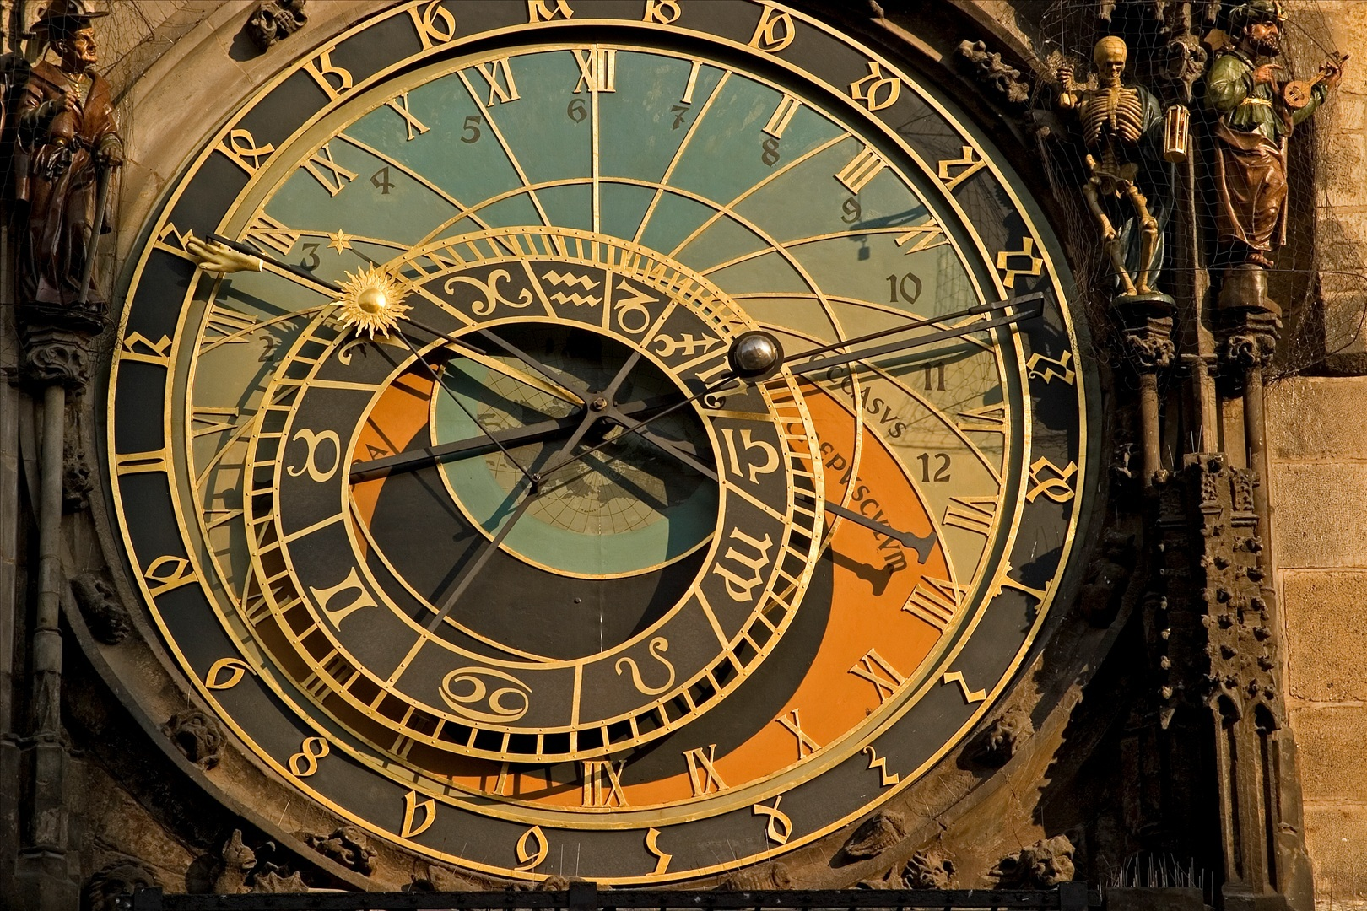
Web 2.0…
Now What?
Learning @ Lovejoy, July, 2013
Jennifer Larriviere, Library Media Specialist, Hart Elementary
Debbie Rohlmeier, Digital Literacy Coach Sloan Creek Intermediate
LISD Instructional Resource Team Members

Slide 2
Poll #1

Slide 3
Poll #2

Slide 4
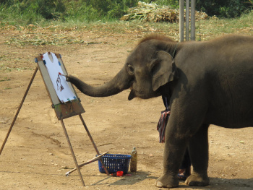
Find the feeling…

Slide 5
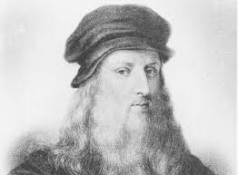
It has long since come to my attention that people of accomplishment rarely sat back and let things happen to them. They went out and happened to things.
-- Leonardo DaVinci

Slide 6
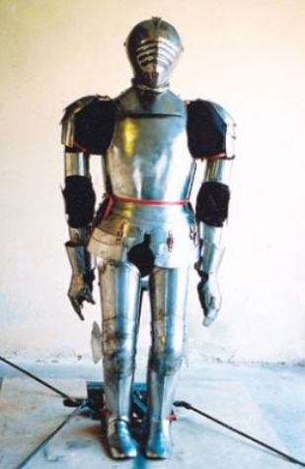
1495

Slide 7
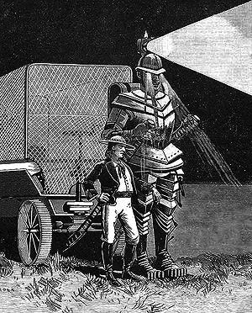
1885

Slide 9
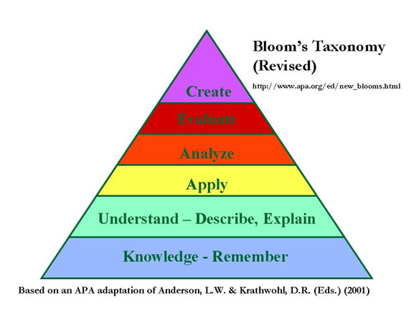

Slide 11
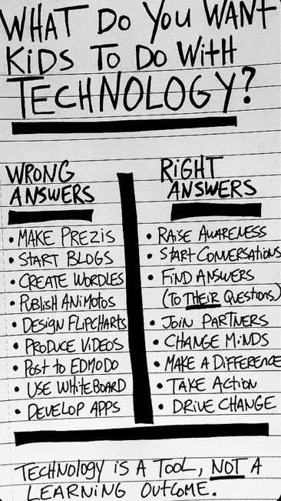
“Until we start seeing technology as nothing MORE than a tool we’ll keep wasting time and cash on products that do nothing to change learning in meaningful ways for our kids.” (Bill Ferriter)

Slide 12
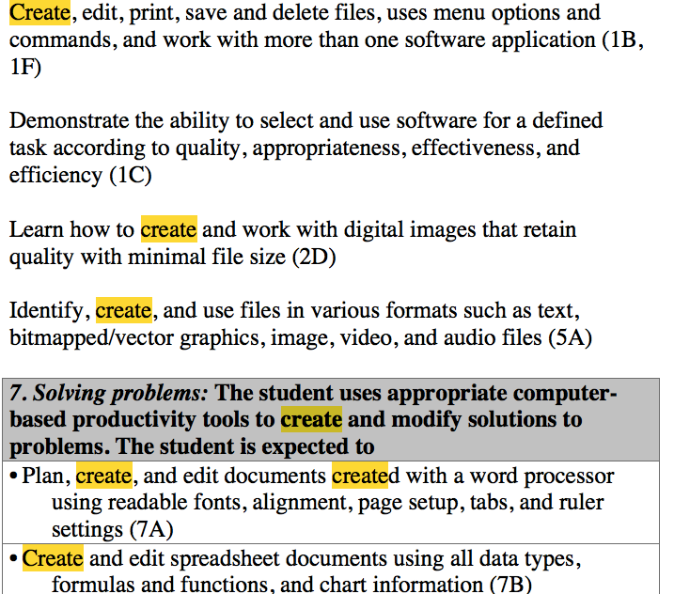

Slide 13
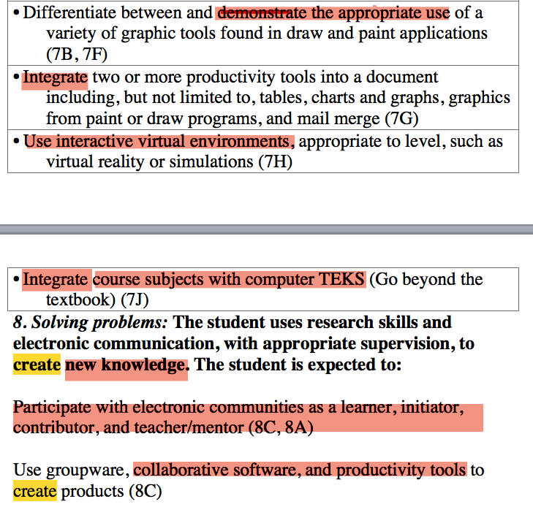

Slide 17
Explore and Evaluate
1. Divide into groups of 2-3. Thinking aloud and talking is encouraged.
2 Select a recorder and researcher (Later you’ll switch roles to get practice).
Researcher will navigate computer and the Recorder will record on
http://todaysmeet.com/LovejoyWebTools observations, ideas, questions,
or concerns.
Explore one category at a time, and choose two if there are more. (You can always go back to review the others at another time.
You'll have 15 minutes to determine: how the tool
works, how you can use it in your classroom, and what you will do with
the finished product.
6. After reviewing several sites, use the evaluation sheet to help you analyze
with more depth.
7. Be prepared to share with the group one, amazing Web 2.0 tool.
Possible Sources for Other Information: the site, reviews, videos, tutorials, www.graphite.com

Slide 19
Reflection
1. Go to Padlet and complete the statements below. http://padlet.com/wall/99cra23fjx
2. Web 2.0 tool that Leonardo would like the most would be ________________ because ________________________.
3. Metaphor – The Web 2.0 tool, ____________, is like a ______________ because _________________.

